Slide 1


FlyEgypt Intranet Solution

Slide 2
Intranet Overview
I-Flights Intranet is a used to track, manage and store documents. It’s capable of keeping a record of the various versions created and modified by system admins.

Slide 3
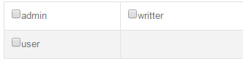
System Roles
User: Doesn’t allowed to see any links in the settings menu, only viewing content and can only edit his own profile.
Writer: Has the same rights as the user with few additional permissions:
Manage Circulars.
Manage Bulletins.
Admin: Has the full access on the system, including all sections in the settings menu.

Slide 4
User Navigation
System User Pages:
Home.
Circulars.
Bulletins.
Blog.
Manuals (Manual versions, Manual Forms and Manual Form Versions).
Aircraft Manuals.
Profile.

Slide 5
Home

Slide 6
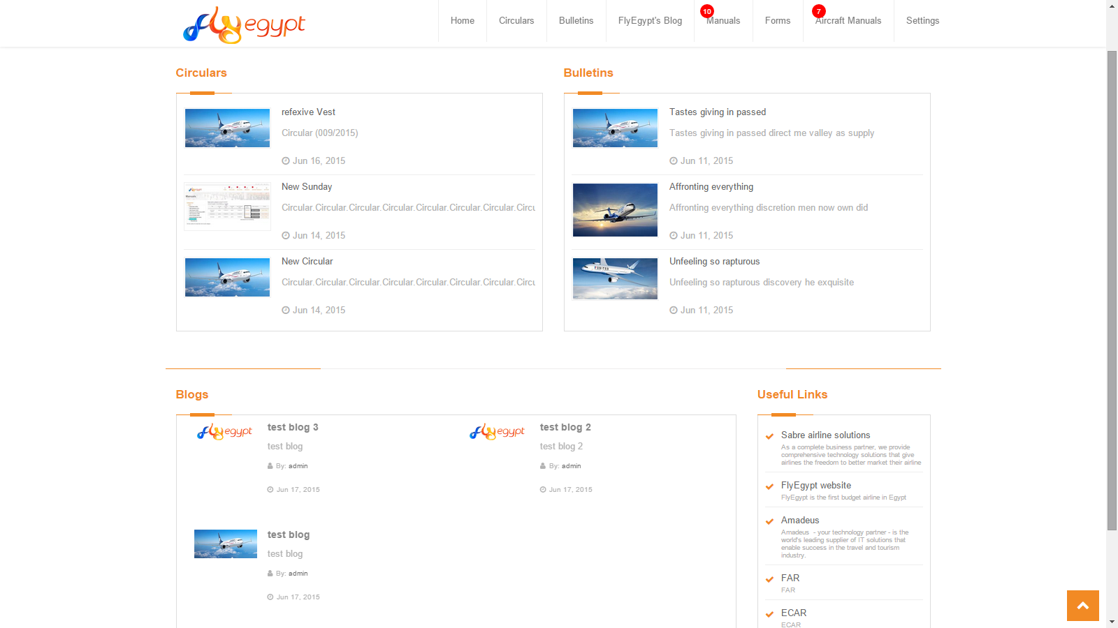

Slide 7
Circulars

Slide 8
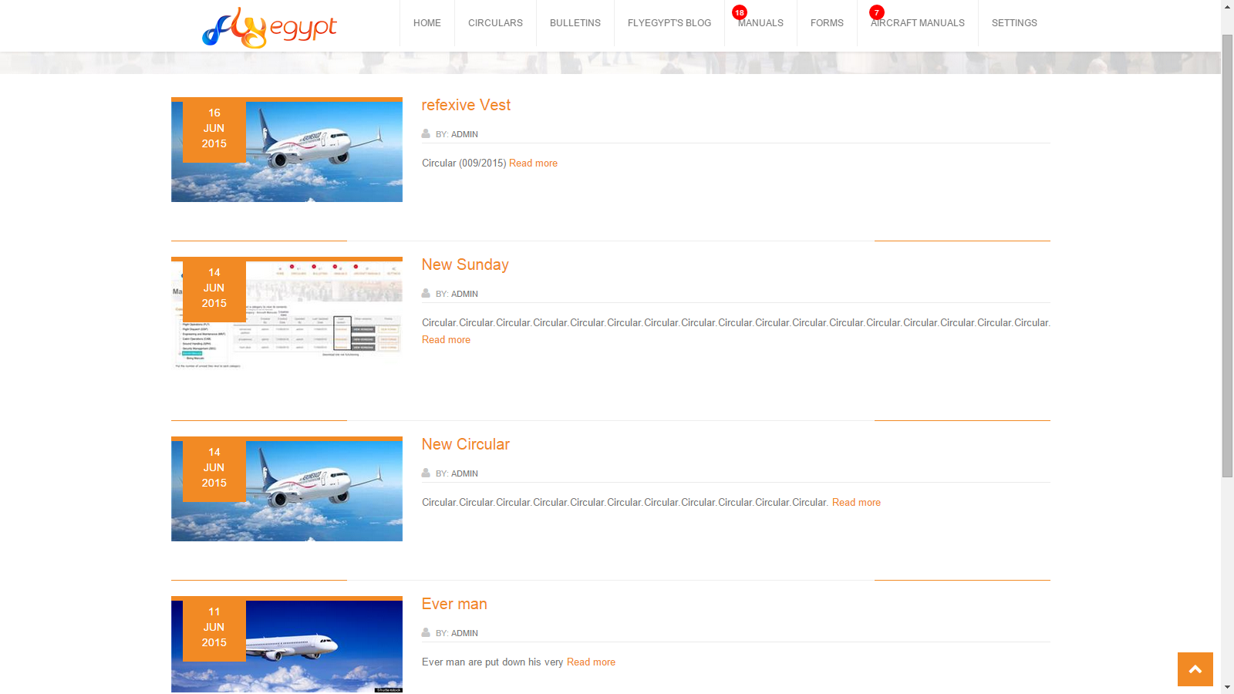

Slide 9
Bulletins

Slide 10
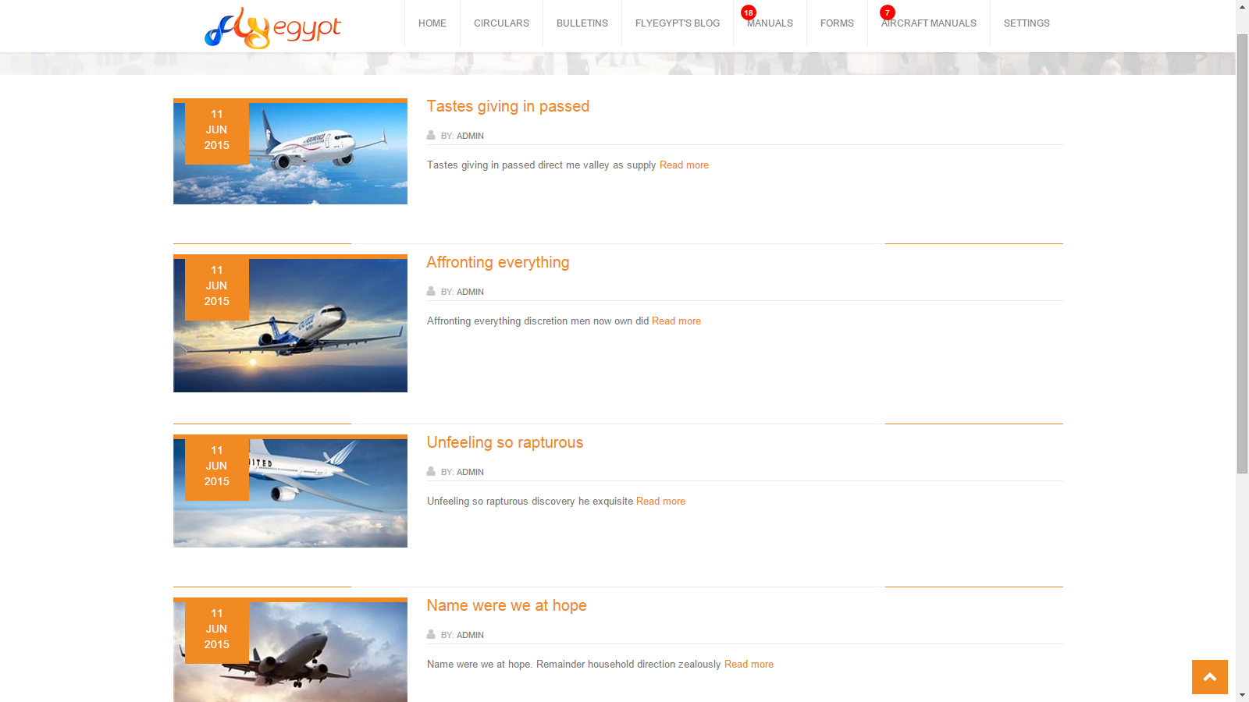

Slide 11
Blog

Slide 12
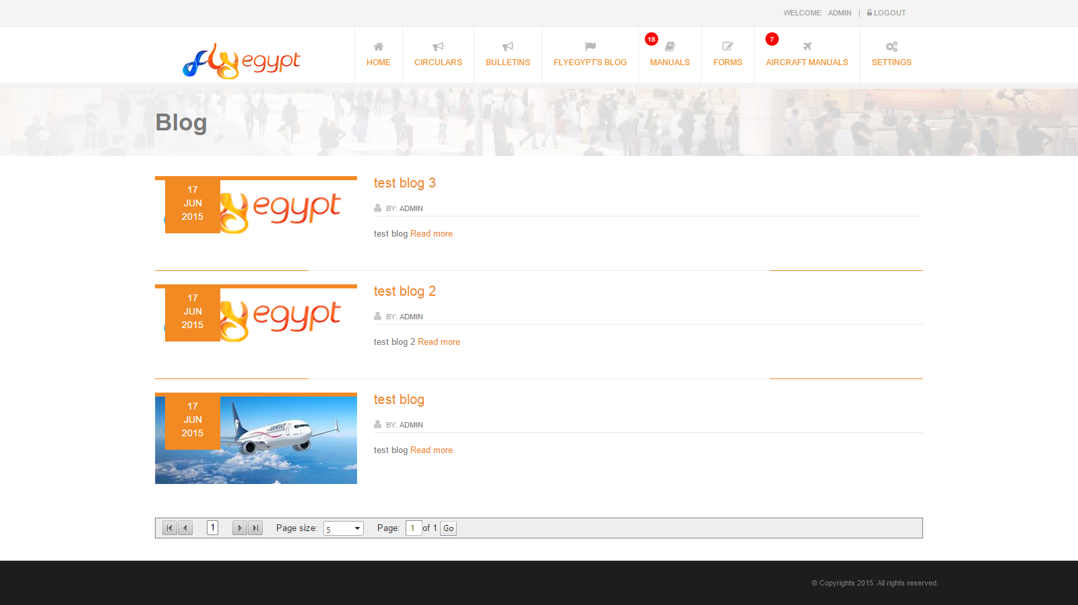

Slide 13
Manual Hierarchy
Manual Categories
Manual
Manual Version
Form
Form Version

Slide 14
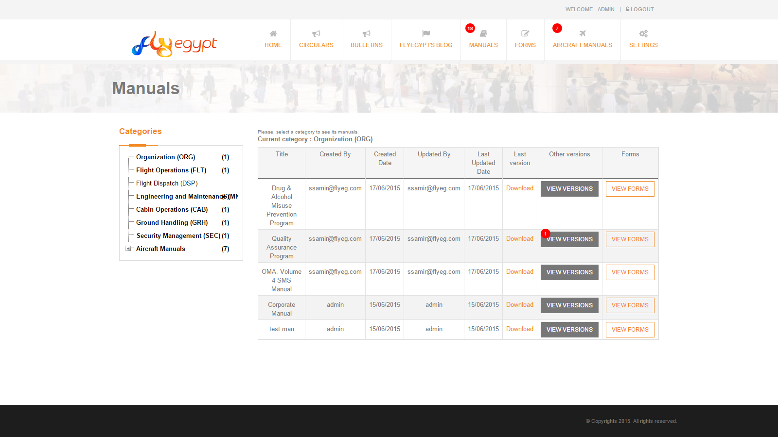
Manuals

Slide 15
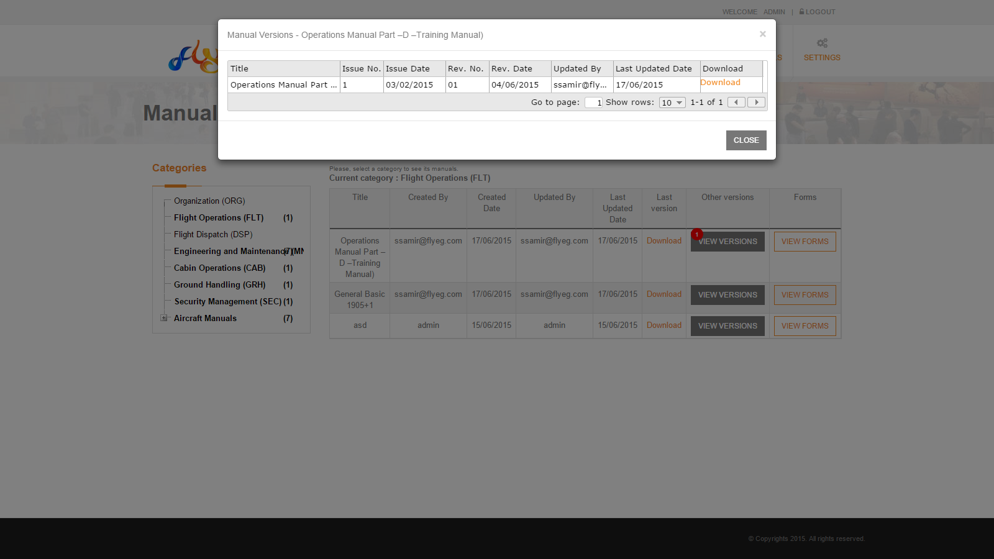
Manual Versions

Slide 16
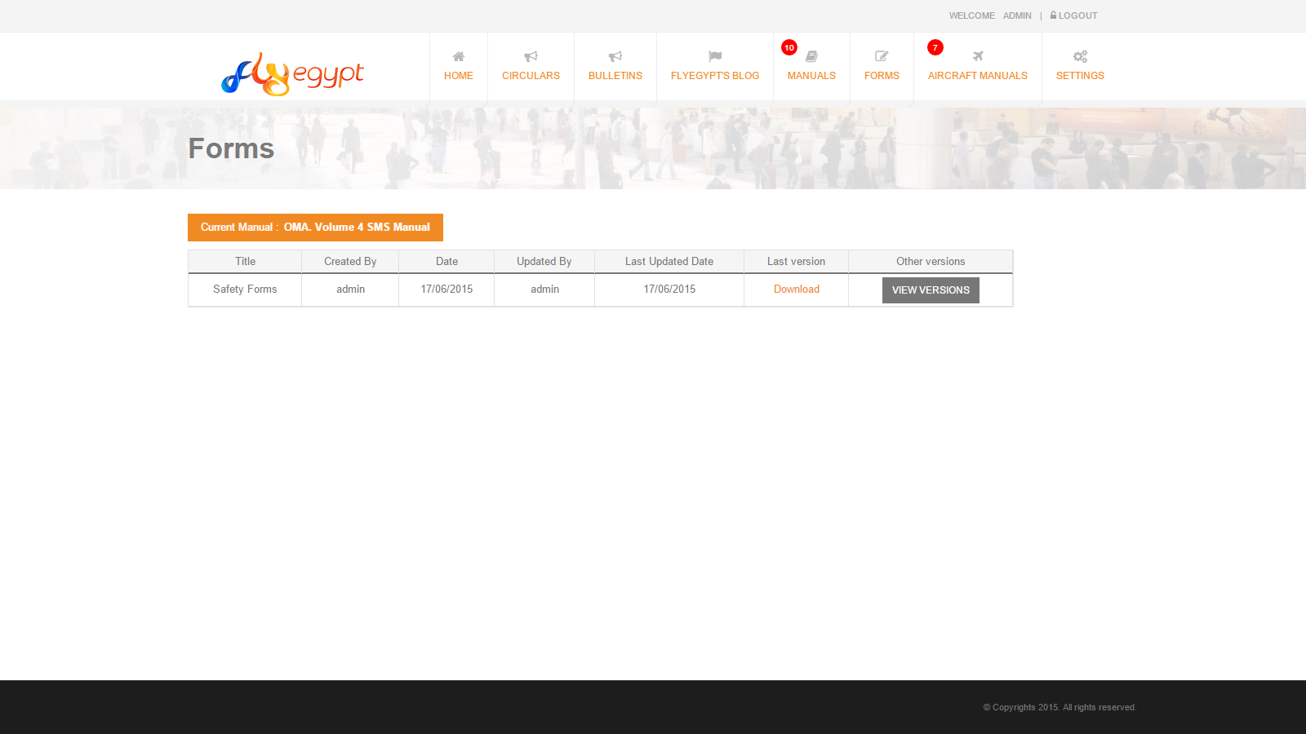
Manual Forms

Slide 17
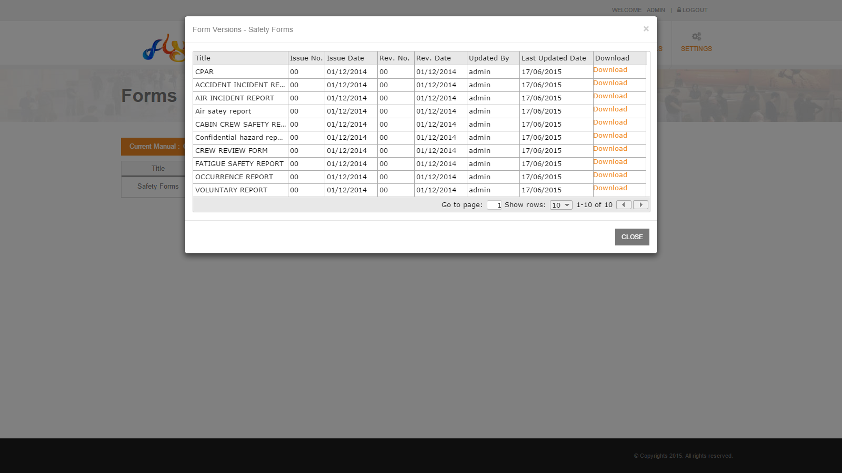
Manual Form Versions

Slide 18
Aircraft Manuals

Slide 19
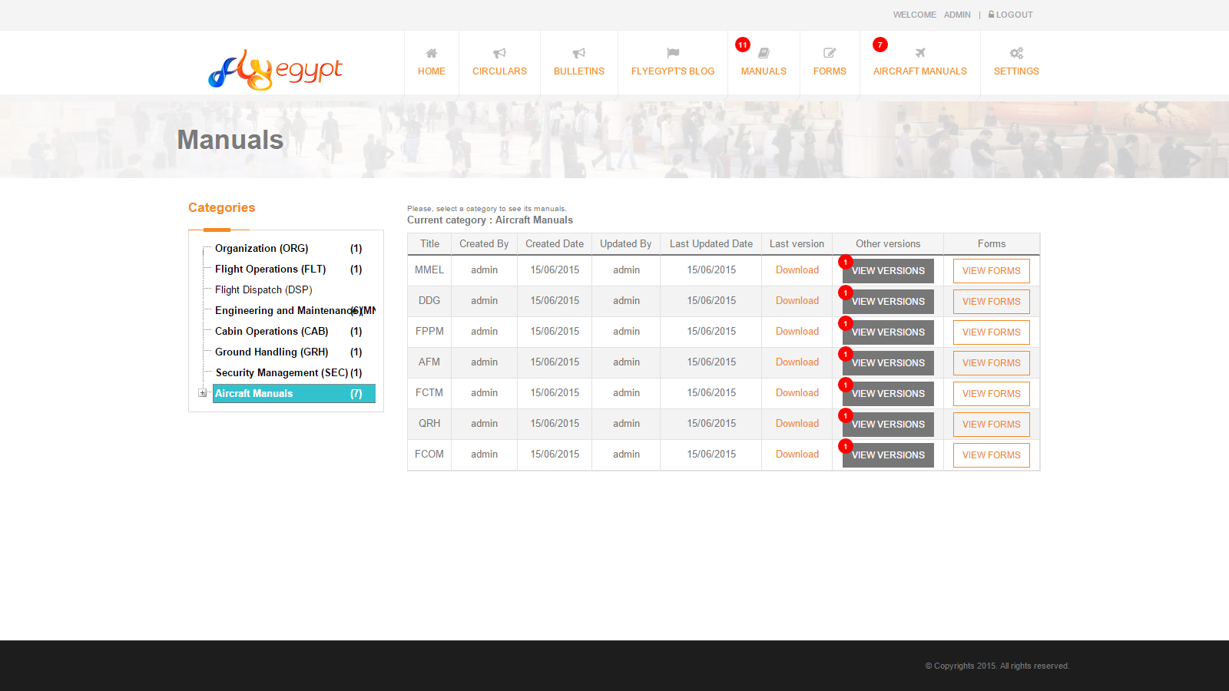

Slide 20
User Profile

Slide 21
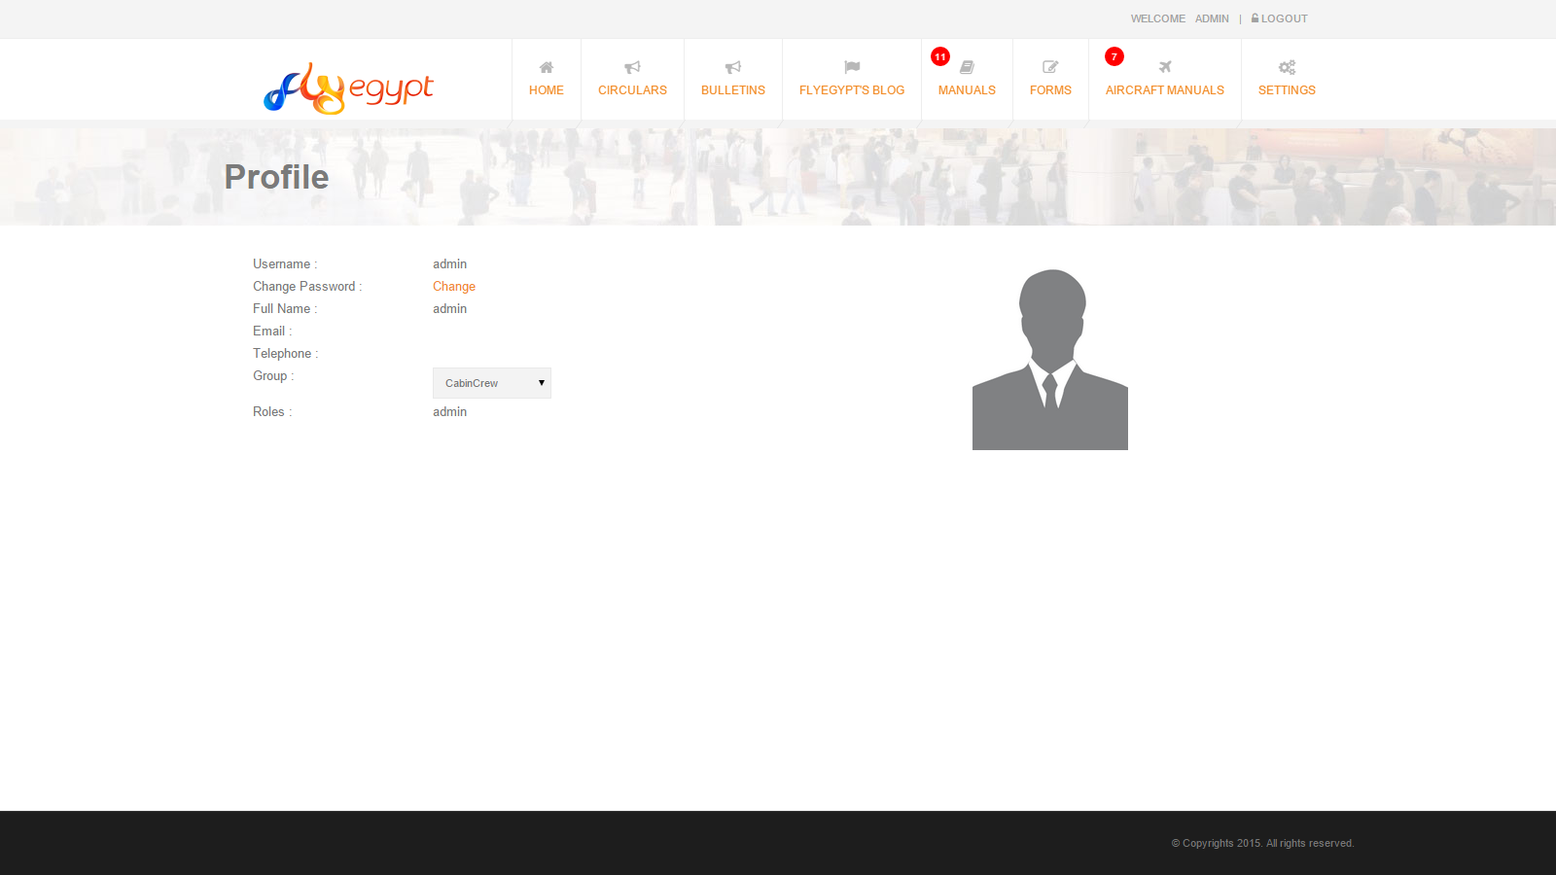
Viewing Profile

Slide 22
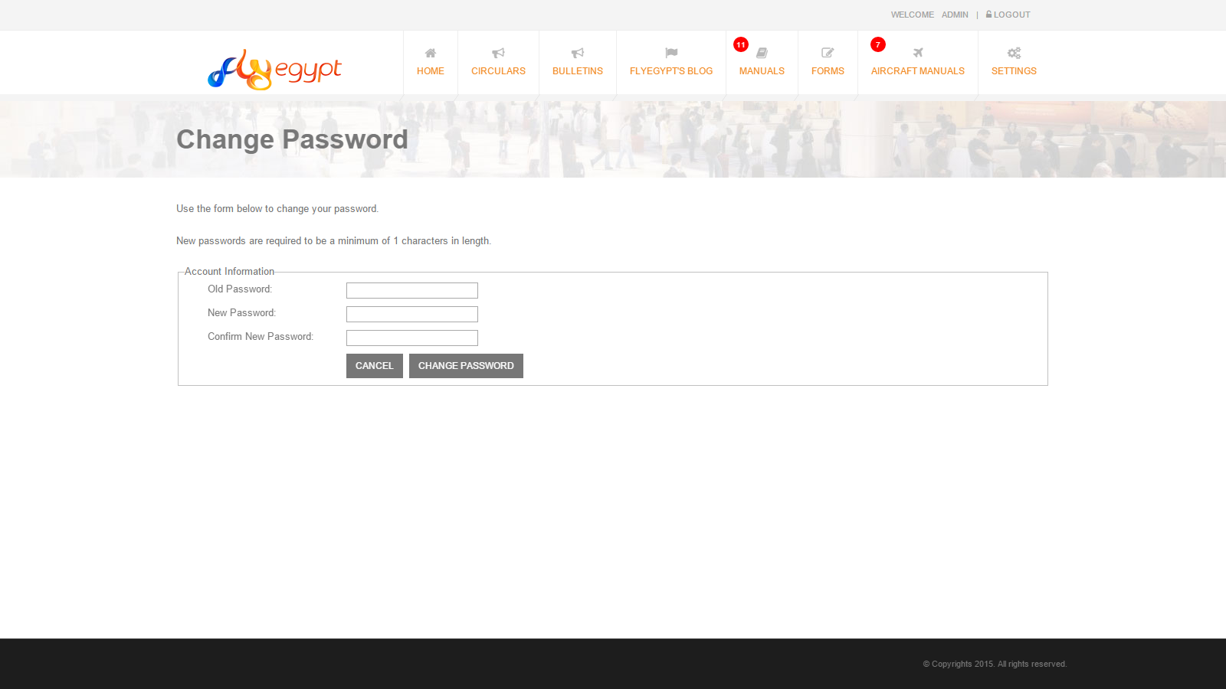
Changing Password

Slide 23
Admin Navigation
System Admin Pages:
Manage Circulars.
Manage Bulletins.
Manage Blog.
Manual Categories.
Manage Manuals
Manage Links.
Manage Users.
Send Notifications.

Slide 24
Manage Circulars

Slide 25
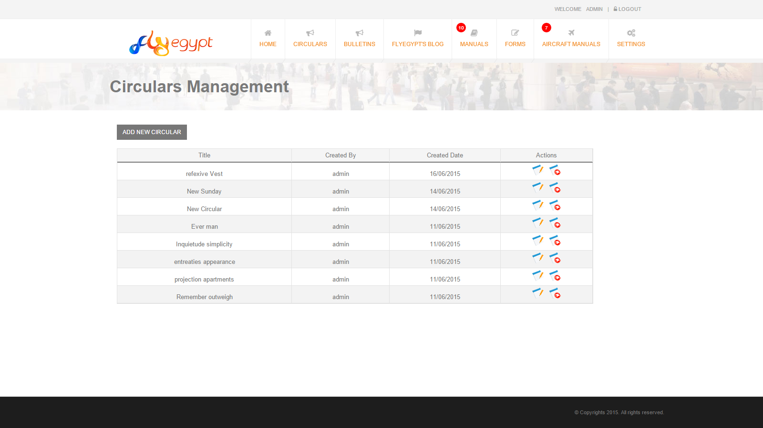
Viewing Circulars

Slide 26
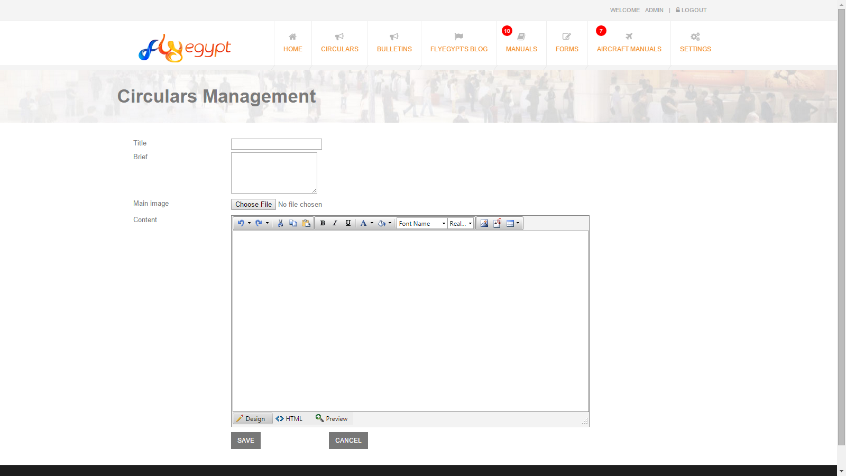
Creating New Circular

Slide 27
Manage Bulletins

Slide 28
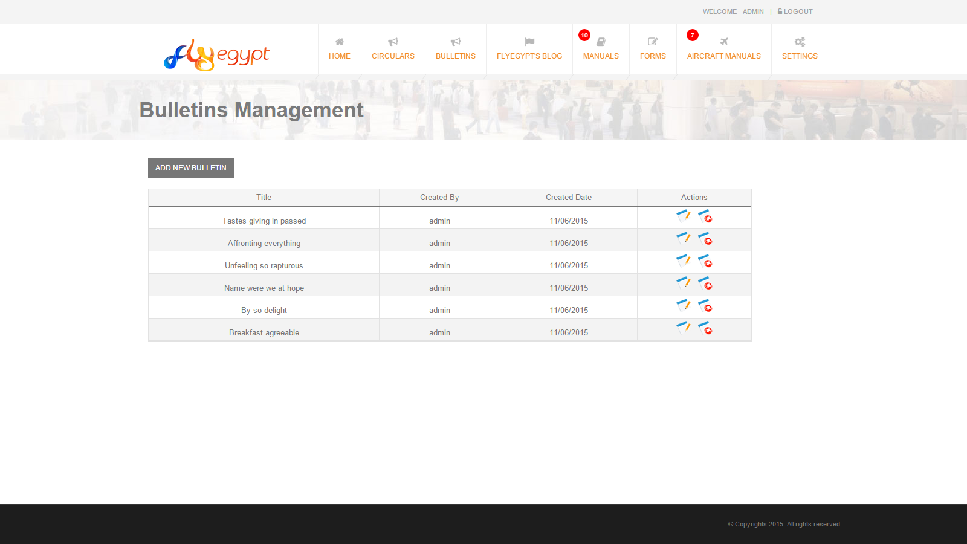
Viewing Bulletins

Slide 29
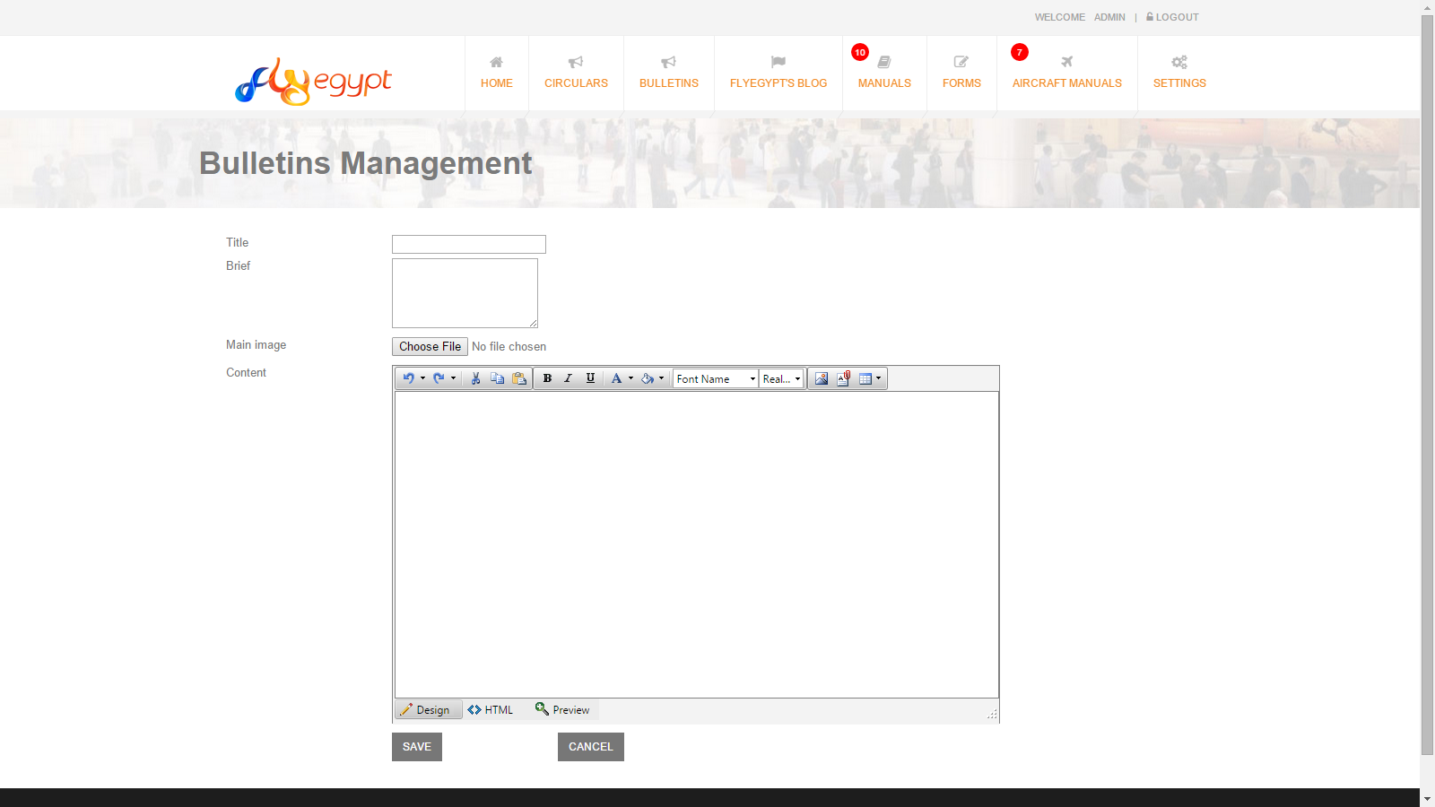
Creating New Bulletin

Slide 30
Manage Blog

Slide 31
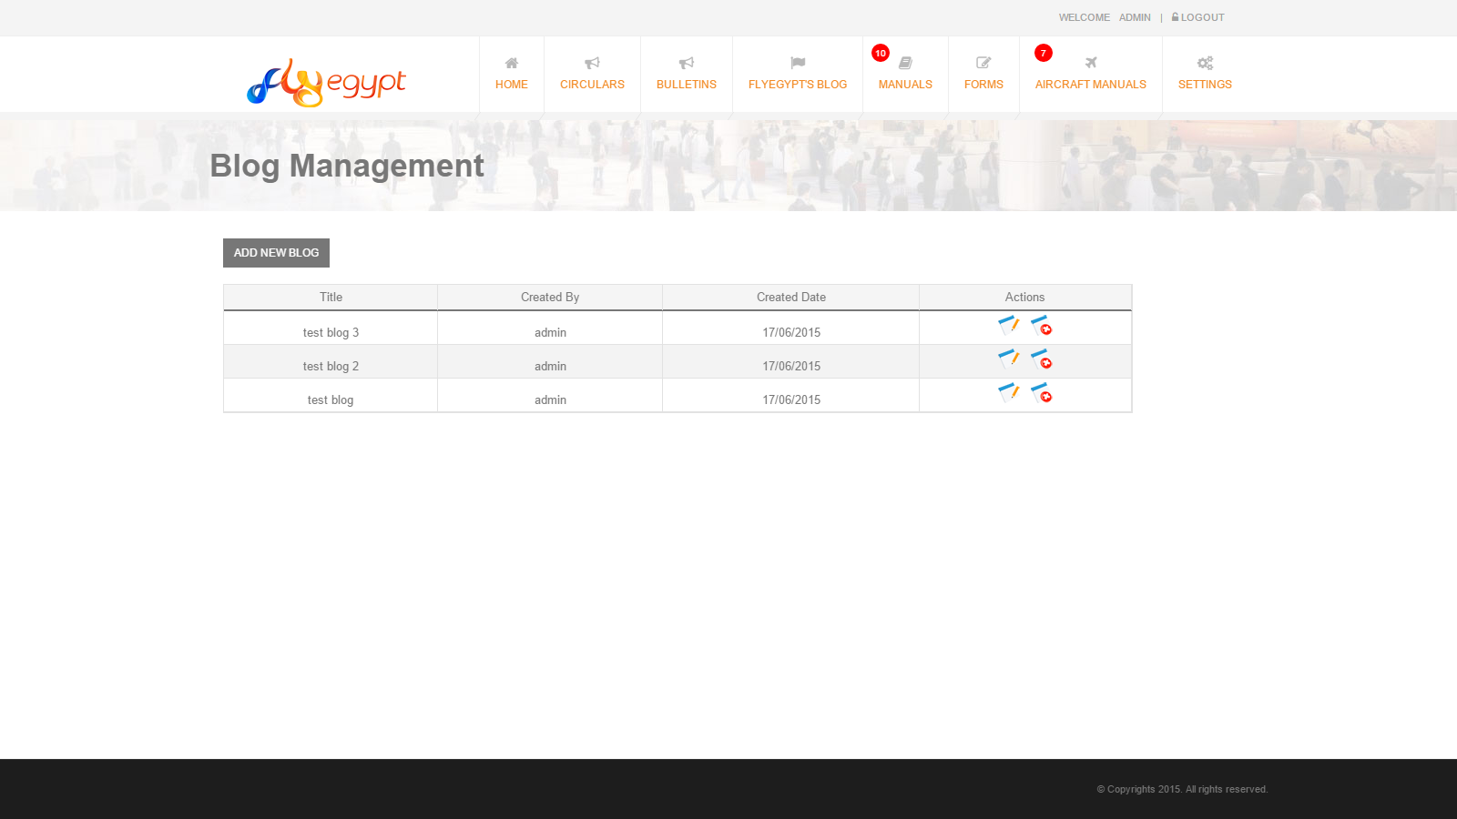
Viewing Blogs

Slide 32

Creating New Blog

Slide 33
Manage Categories

Slide 34
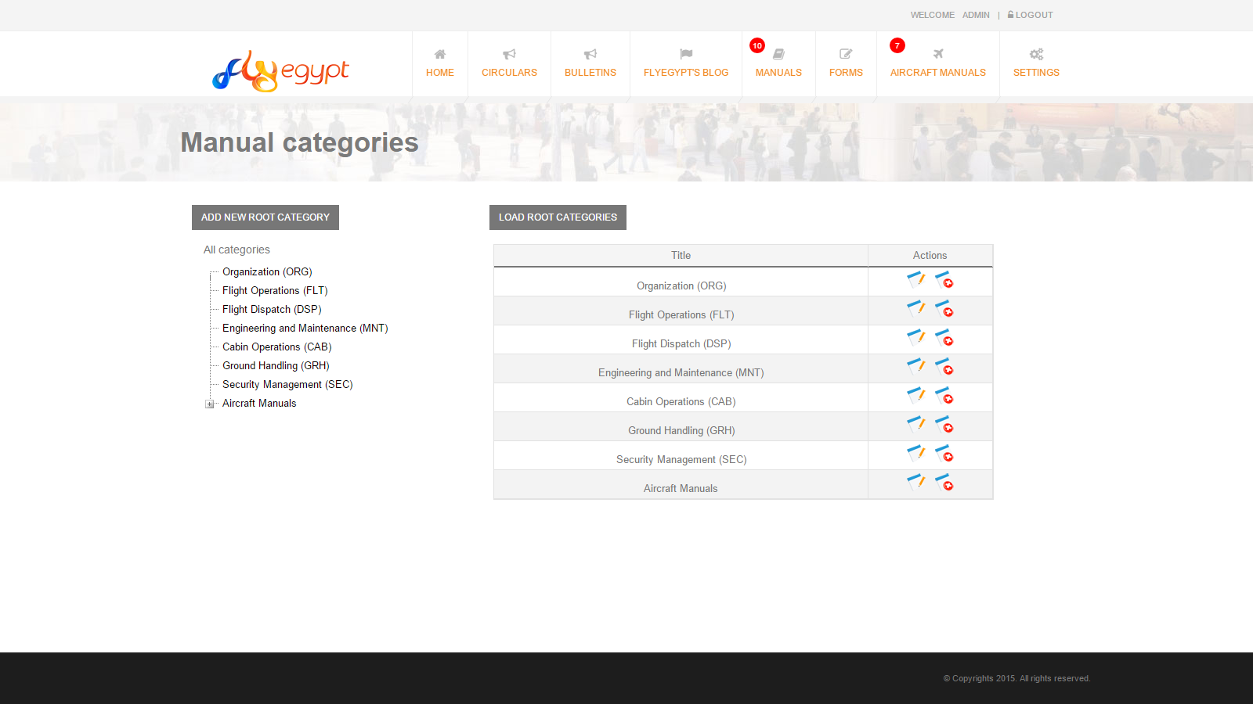
Viewing Manuals Categories

Slide 35
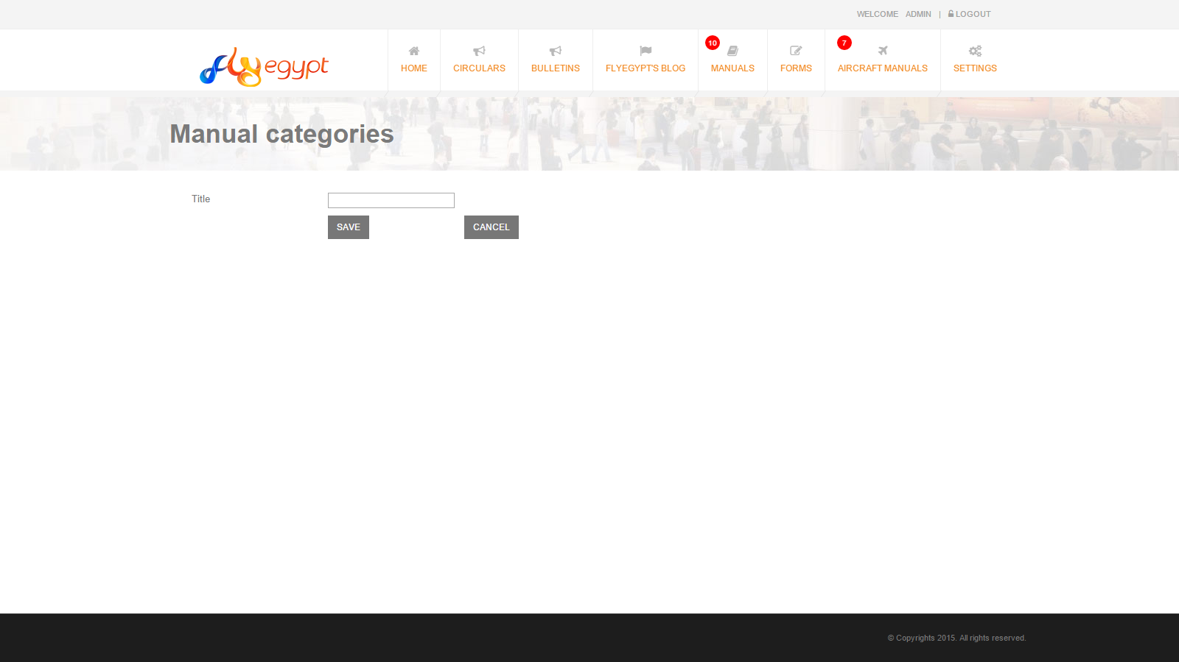
Creating New Manual Category

Slide 36
Manage Manuals

Slide 37
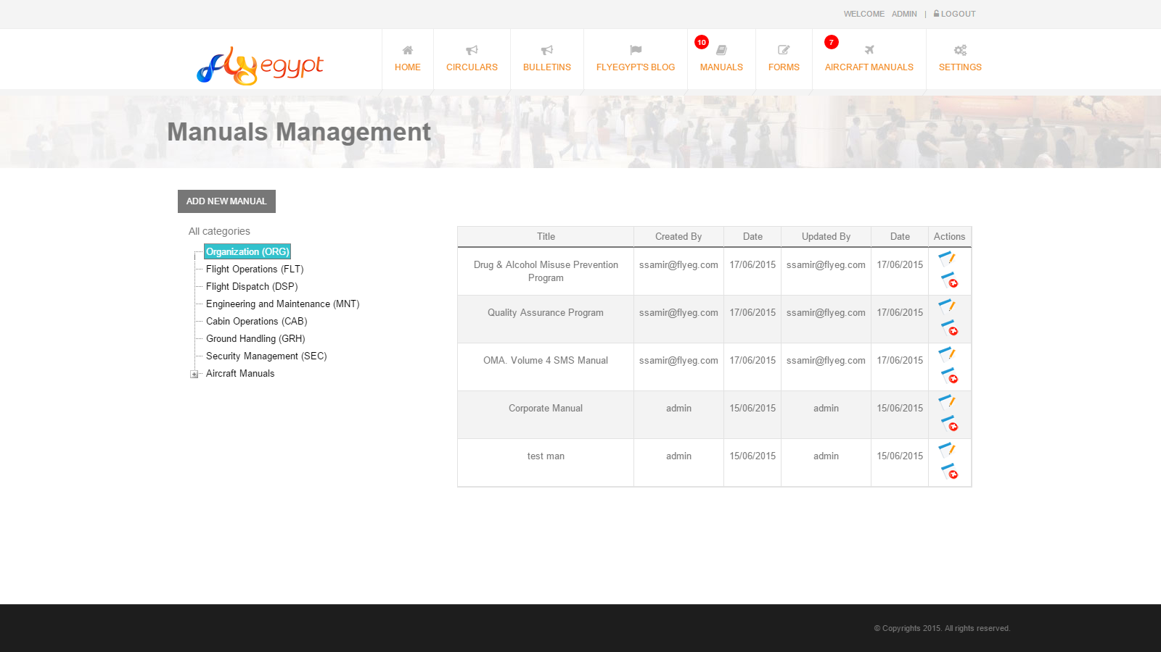
Viewing Manuals

Slide 38
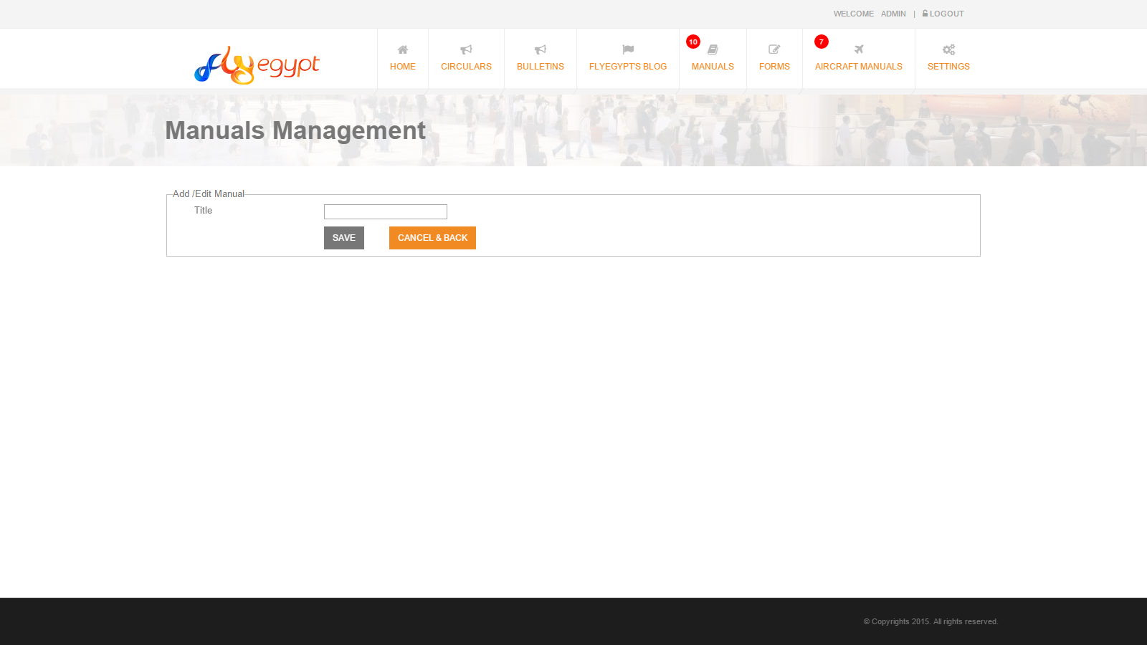
Creating New Manual

Slide 39
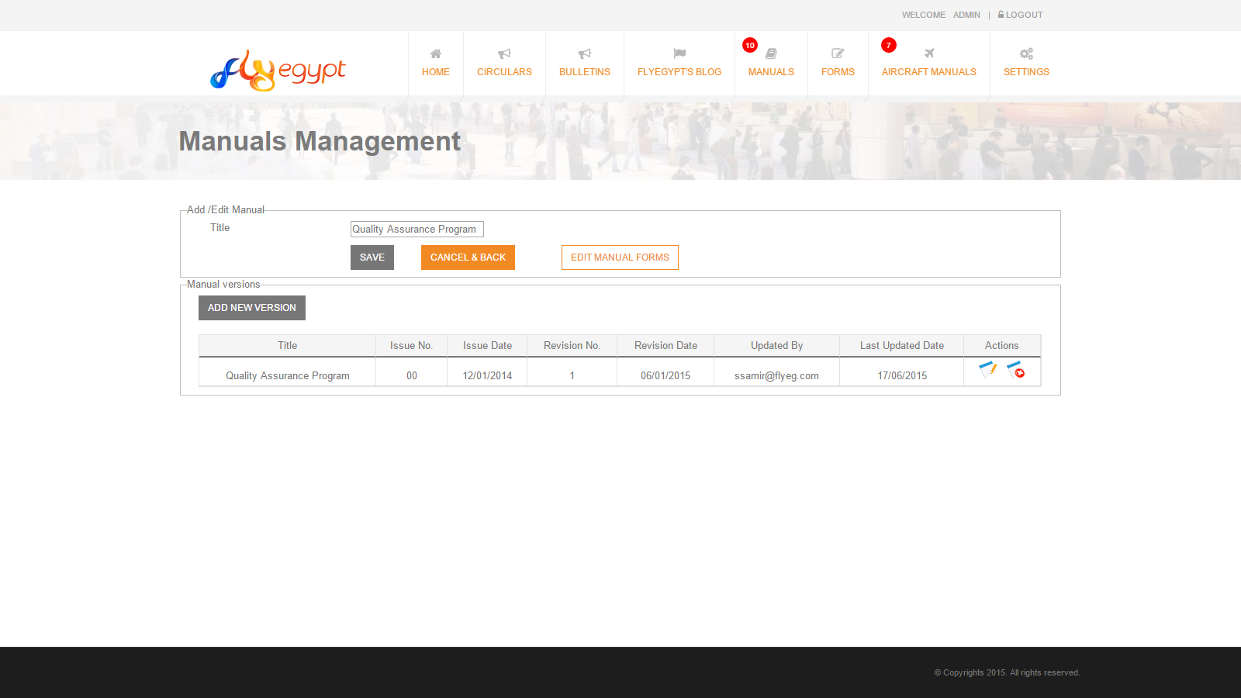
Editing Manual
Overviewing Manual Versions

Slide 40
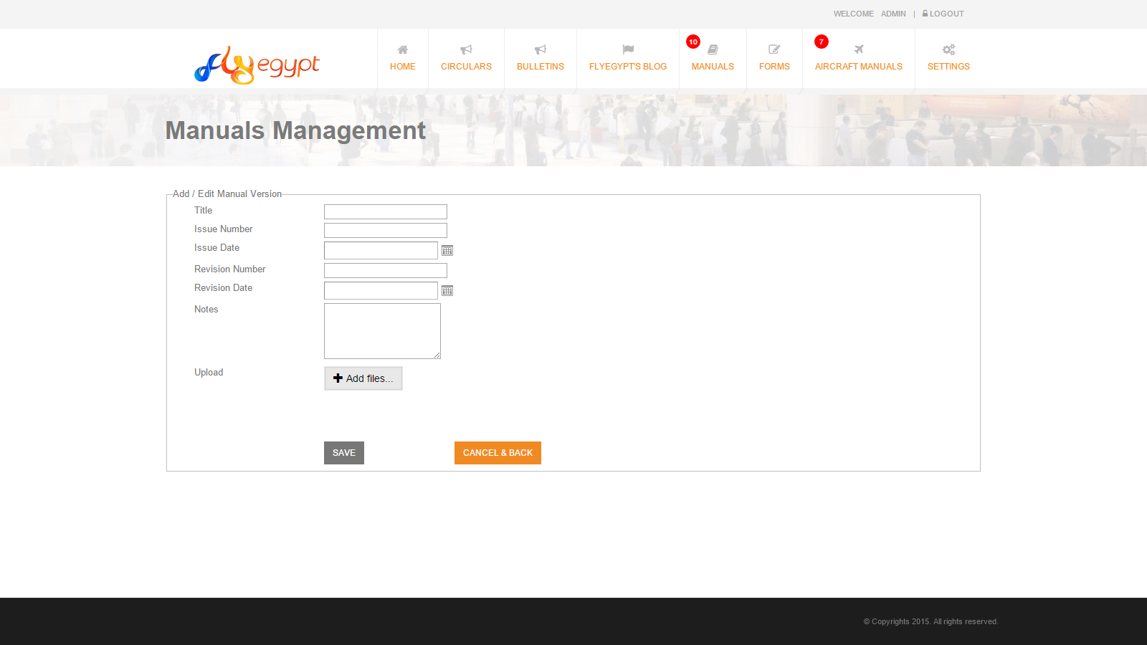
Creating New Manual Version

Slide 41
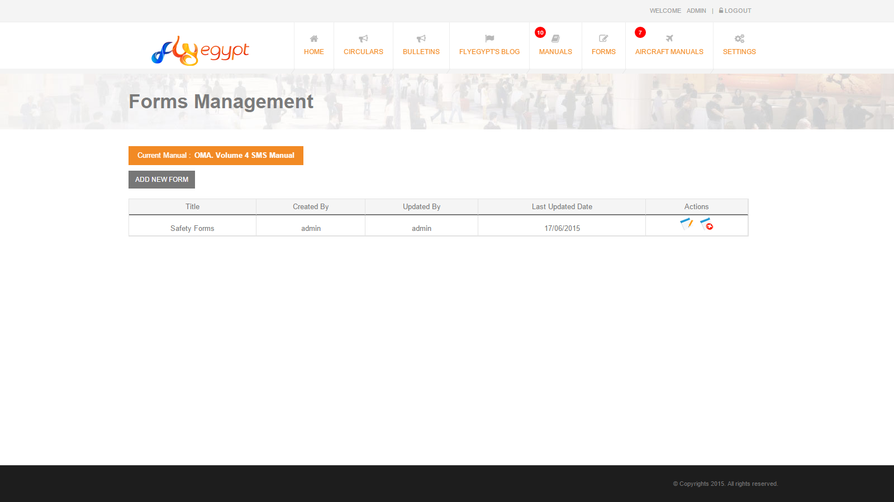
Forms Overview

Slide 42
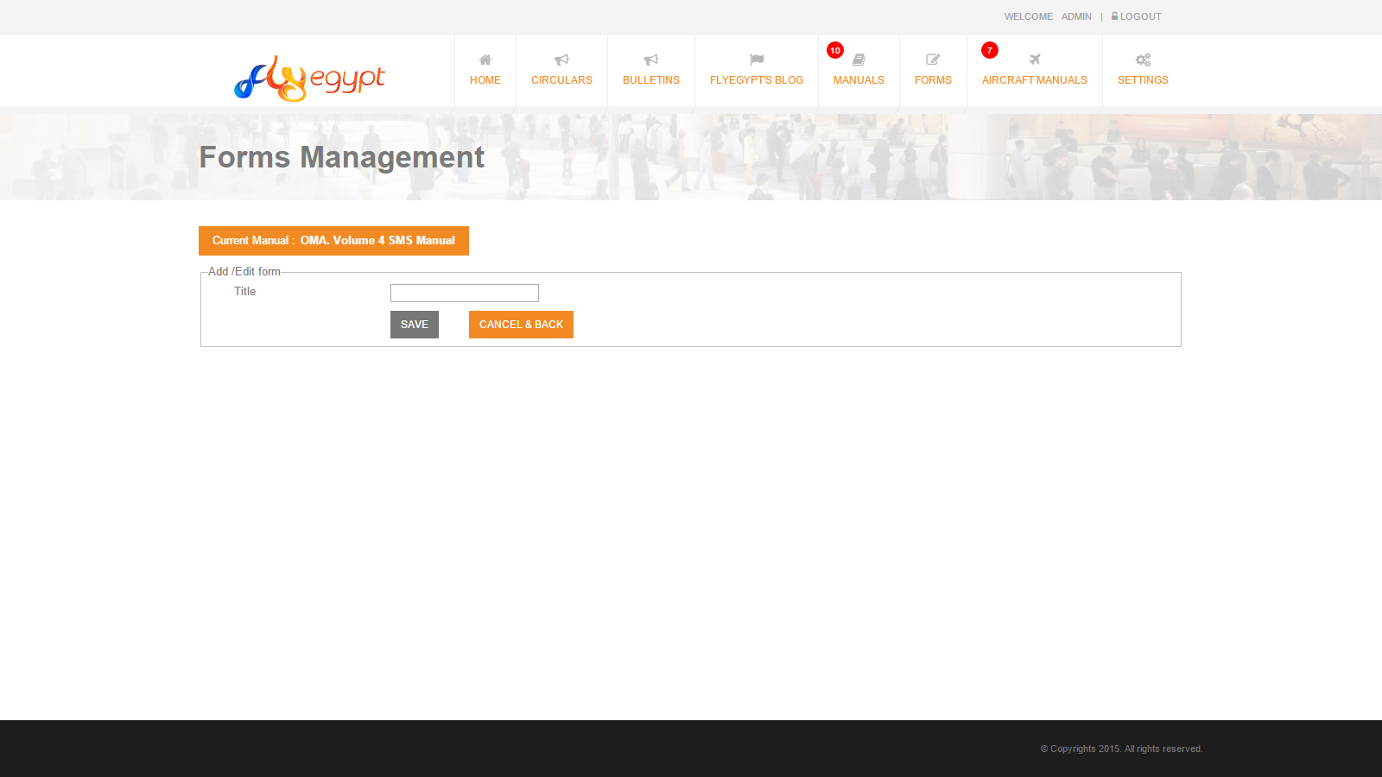
Creating New Form

Slide 43
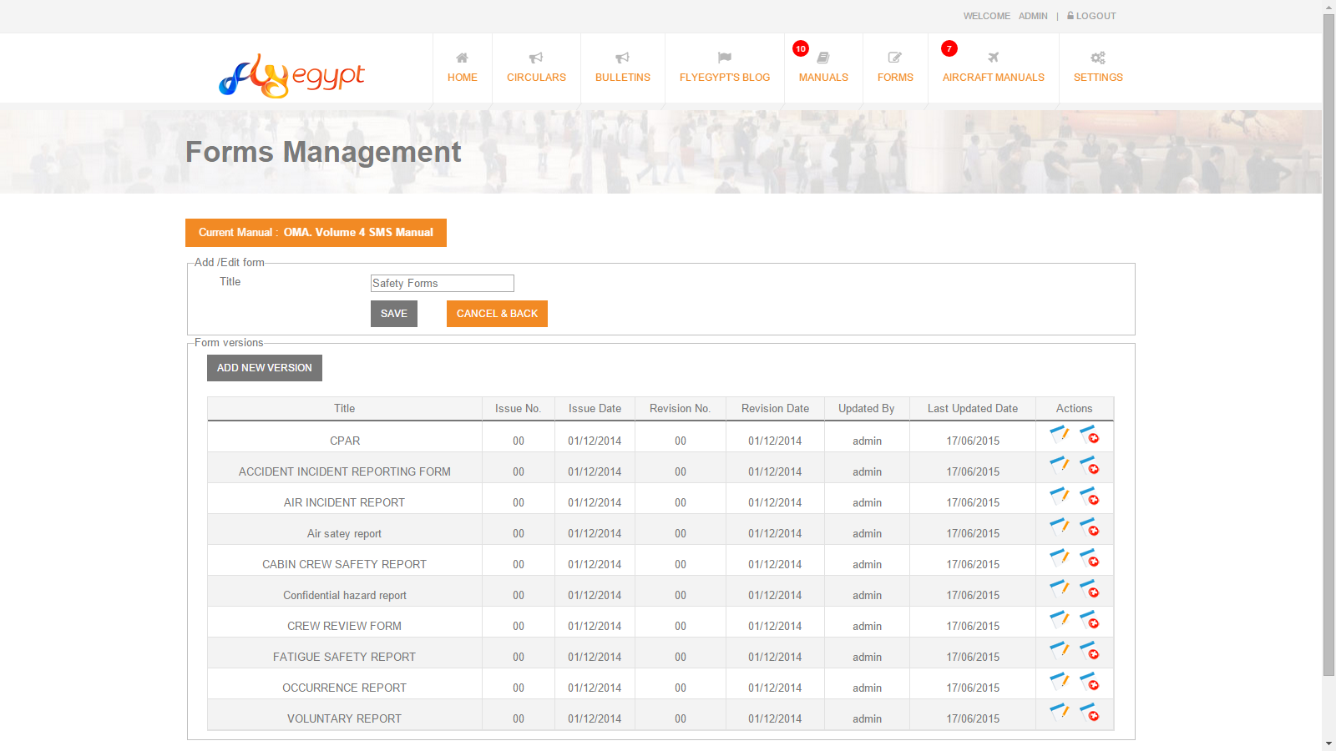
Editing Form
Overviewing Form Versions

Slide 44
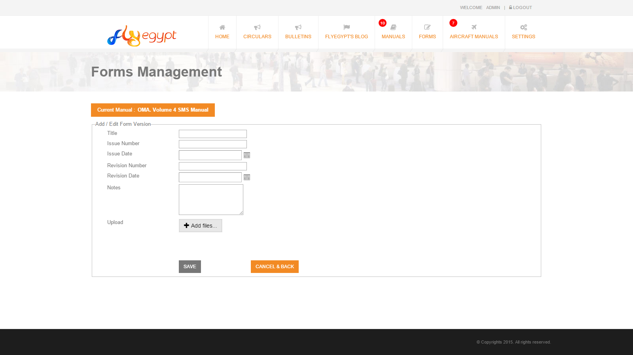
Creating New Form Version

Slide 45
Links Management

Slide 46
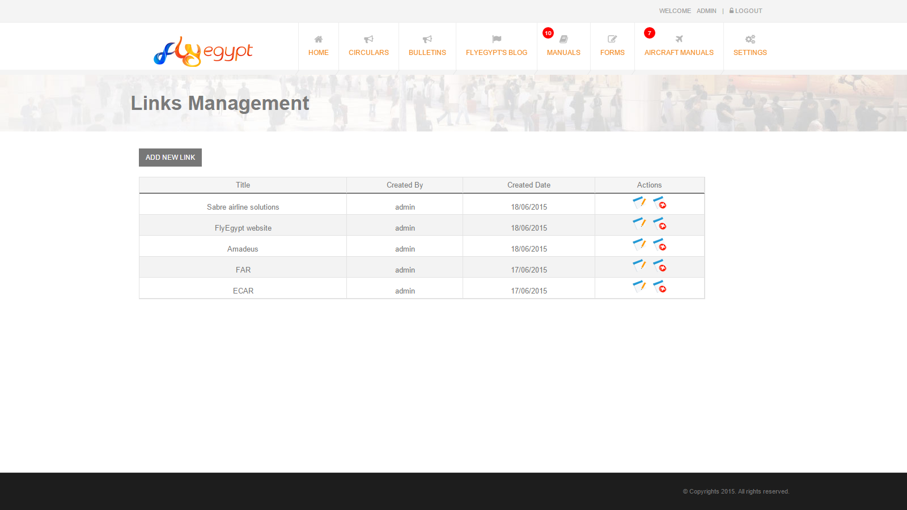
Links Overviewing

Slide 47
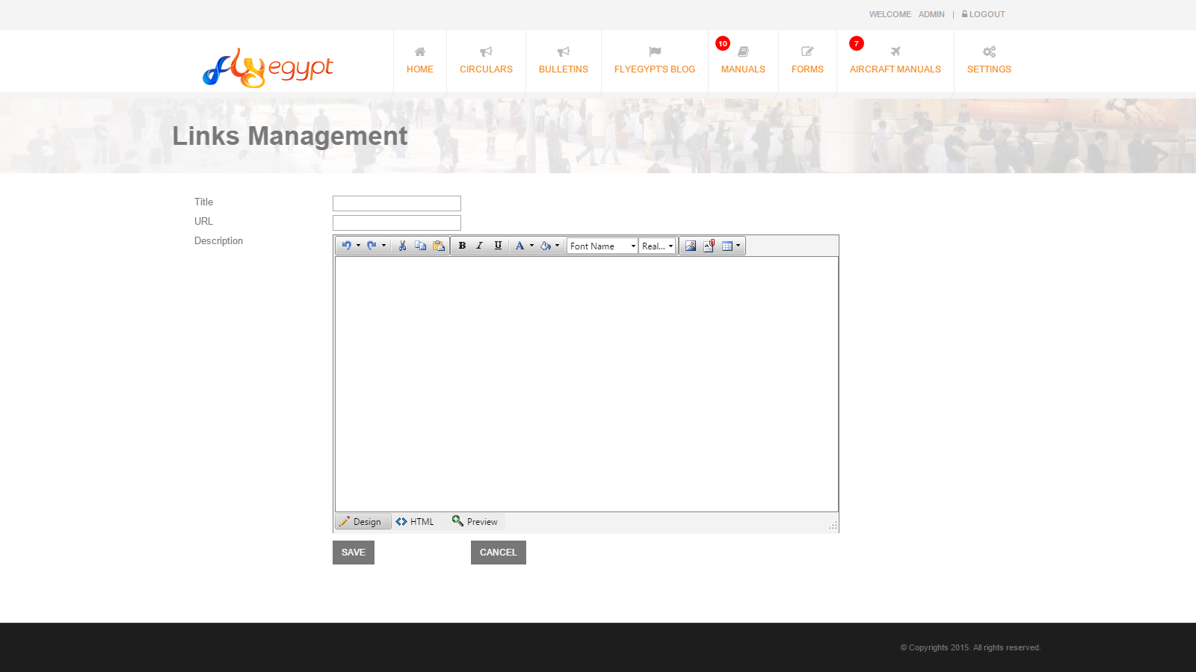
Creating New Link

Slide 48
User Management

Slide 49
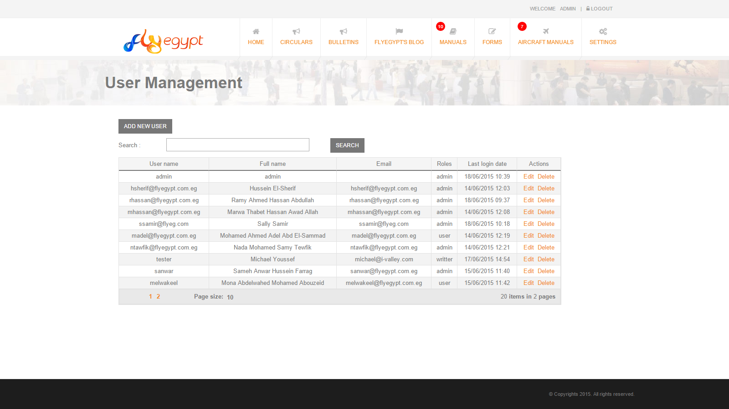
Users Overview

Slide 50
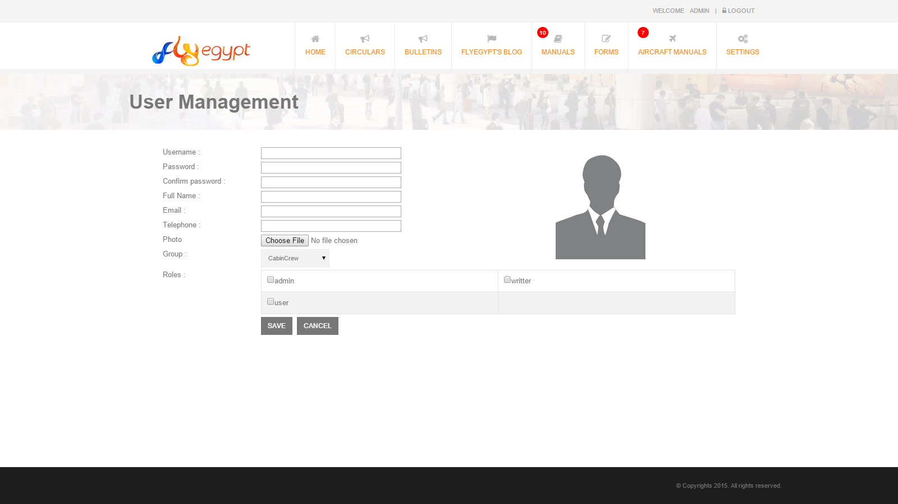
Creating New User

Slide 51
Sending Notifications

Slide 52
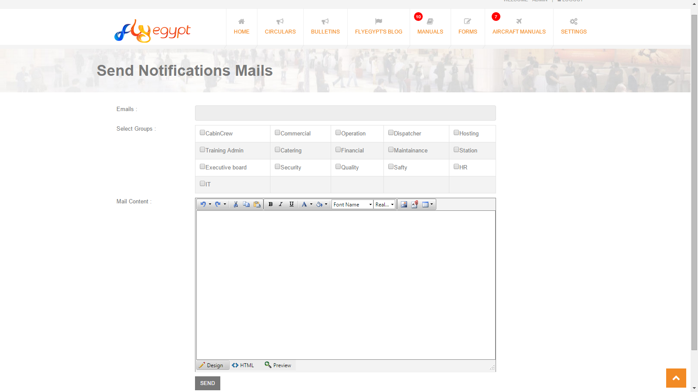

Slide 53
Thank You

